Slide 1
Movie Recommendation System
Faizan Ali

Slide 2

EDA - Summary

Slide 3
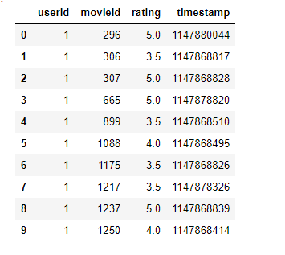
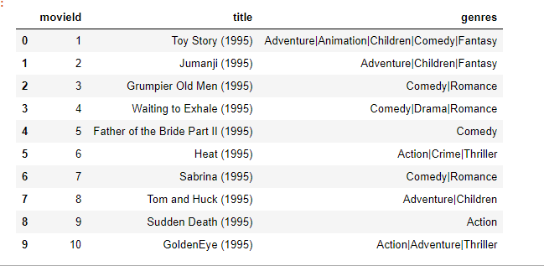
Movielens 25M dataset - EDA
162,541 Users
64,243 movies
Ratings between 1.0-5.0
On average each movie has 423 unique user rantings on it
All movies rated by at least 1 user
Each user has given ratings to at least 20 unique Movies

Slide 4
SVD - Singular Value Decomposition

Slide 5
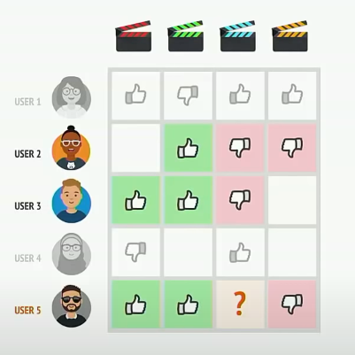
Collaborative Filtering
Provide movie recommendations based on existing rating by similar users
Data used:
  Users
  Ratings
  Movie Titles

Slide 6

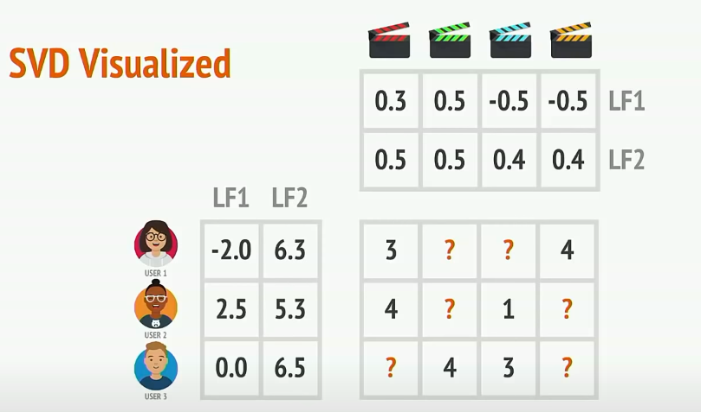
SVD – Singular Value Decomposition
Matrix factorization technique that reduces the number of features
Use dot product between the latent features of movie and user to predict the rating

Slide 7
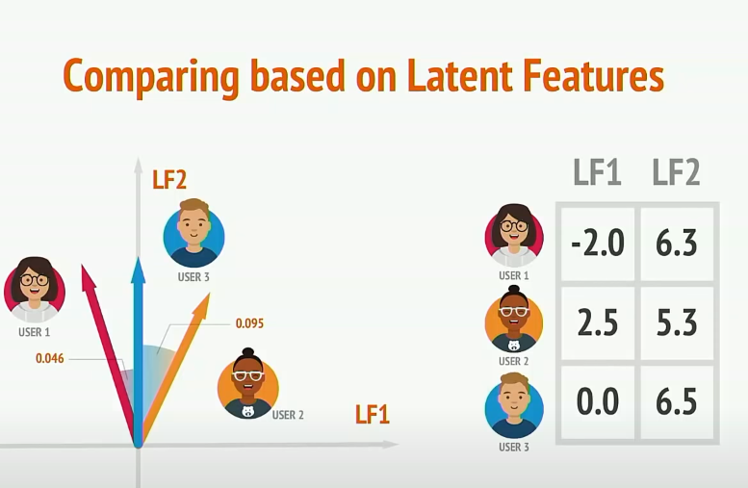
SVD – Singular Value Decomposition
We can compare users with other users or a movie with other movies to find similarity
Cosine similarity

Slide 8
Model Training Results

Slide 9
Root mean Squared(RMSE)
RMSE: 0.7854
The Root mean Squared Error of the model is 0.7854 which means that the predicted ratings is within +/- 0.7854 of the actual rating for our model

Slide 10
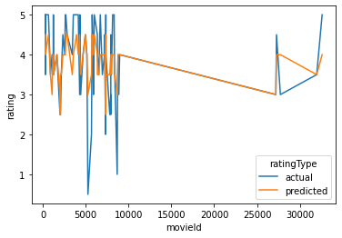
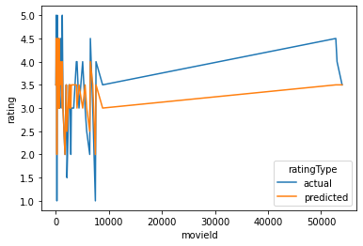
comparing predicted vs actual
User 1 Predicted vs Actual
User 10 Predicted vs Actual
The predicted and actual rating for the users follows a similar patter but not exactly the same value for some movies
This can be explained by the RMSE of 0.7854
  Our predicted ratings are anywhere between +/-0.78 of the actual rating due to which we can see that predicted rating follows similar pattern to actual but does not exactly match it.

Slide 11

Deployment
While I was not able to make a proper GUI for the recommender system, I did create a simple application where you can input the name of a movie and it will give you top 5 similar movies

